Slide 1
OpenFPM: Illuminator Assembly Instructions
- Lewis Walker
- University of Strathclyde, Glasgow, Scotland
- Last Edited: 11th August 2026

Slide 2
Components
Here we provide a list of the components (and their quantity) required to assemble the illuminator:
3D Printed Components:
External post (x3)
Internal post (x3)
LED box hat (x1)
LED box holder (x1)
LED canopy (x1)
Microscope base plate (x1)
Hex Nut Tool (x1) - Tool
Metal Components:
M6x16 mm bolt (x1)
M6x20 mm bolt (x3)
M6x25 mm bolt (x3)
M6x30 mm bolt (x3)
M6 nuts (x6)
Consumables + Tools
Super-glue
5 mm hex key M6 tool
2.5 mm hex key M3 tool

Slide 3
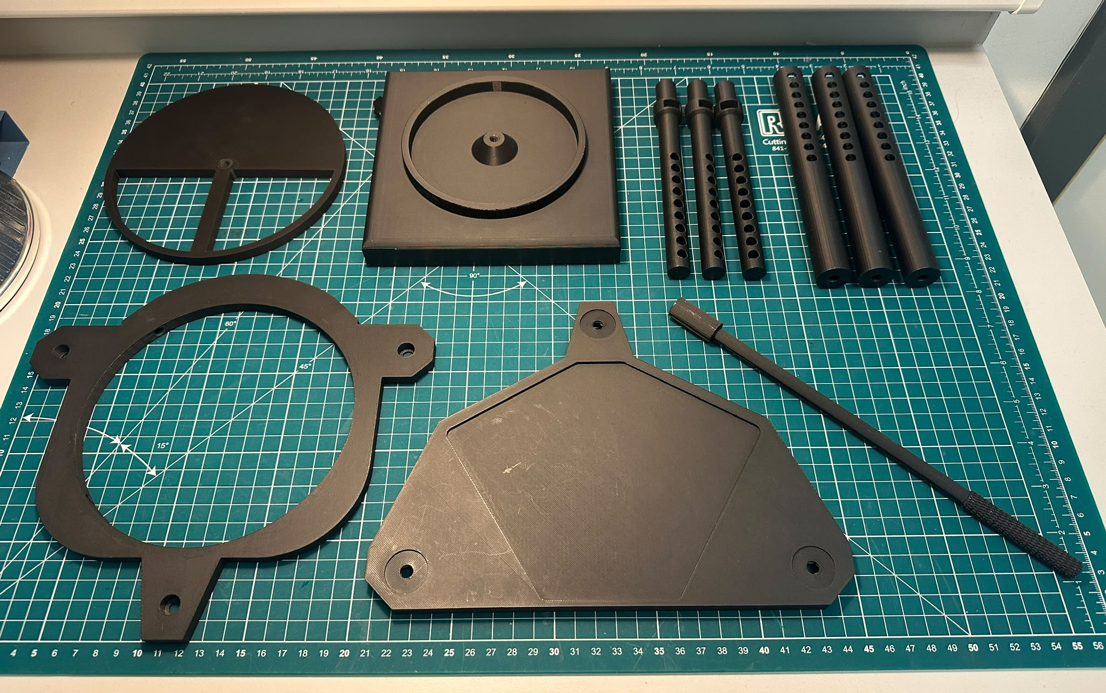
Parts I
From Left to Right on the image
Top:
LED box hat (x1)
LED box holder + LED array (under) (x1)
Internal post (x3)
External post (x3)
Bottom:
LED canopy (x1)
Microscope base plate (x1)
Hex Nut Tool (x1)

Slide 4
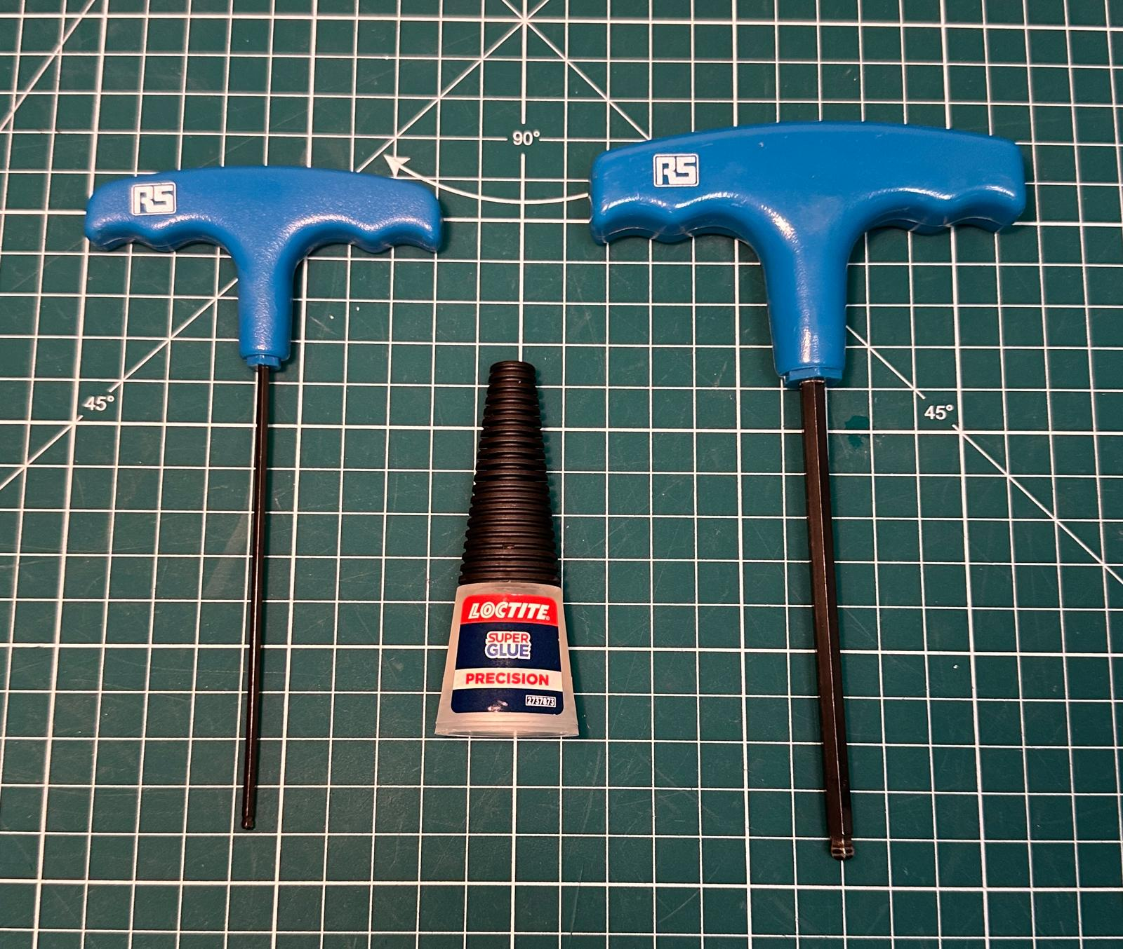
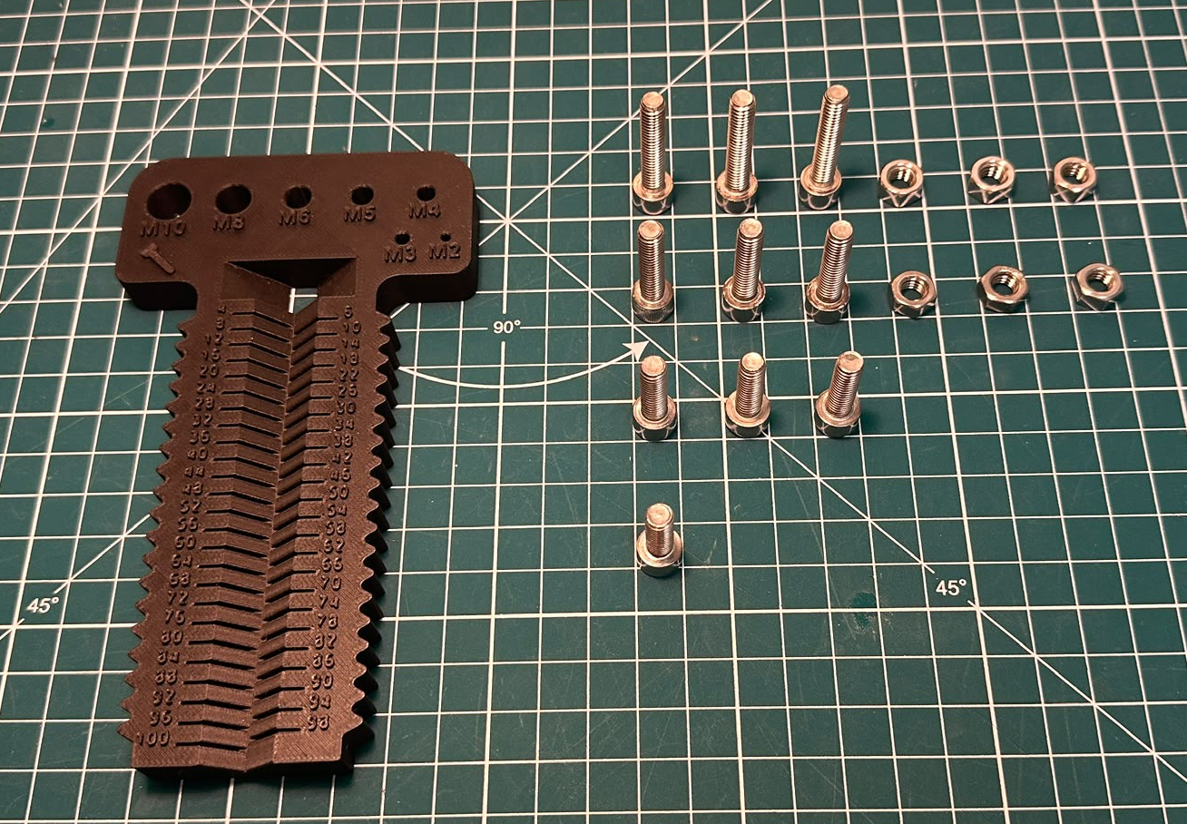
Parts II
Consumables + Tools:
Super-glue
5 mm hex key M6 tool
2.5 mm hex key M3 tool
Optional:
3D printed bolt measuring tool
Metal components:
M6 nuts (x6)
M6x30 bolt mm (x3)
M6x25 bolt mm (x3)
M6x20 bolt mm (x3)
M6x16 bolt mm (x1)

Slide 5
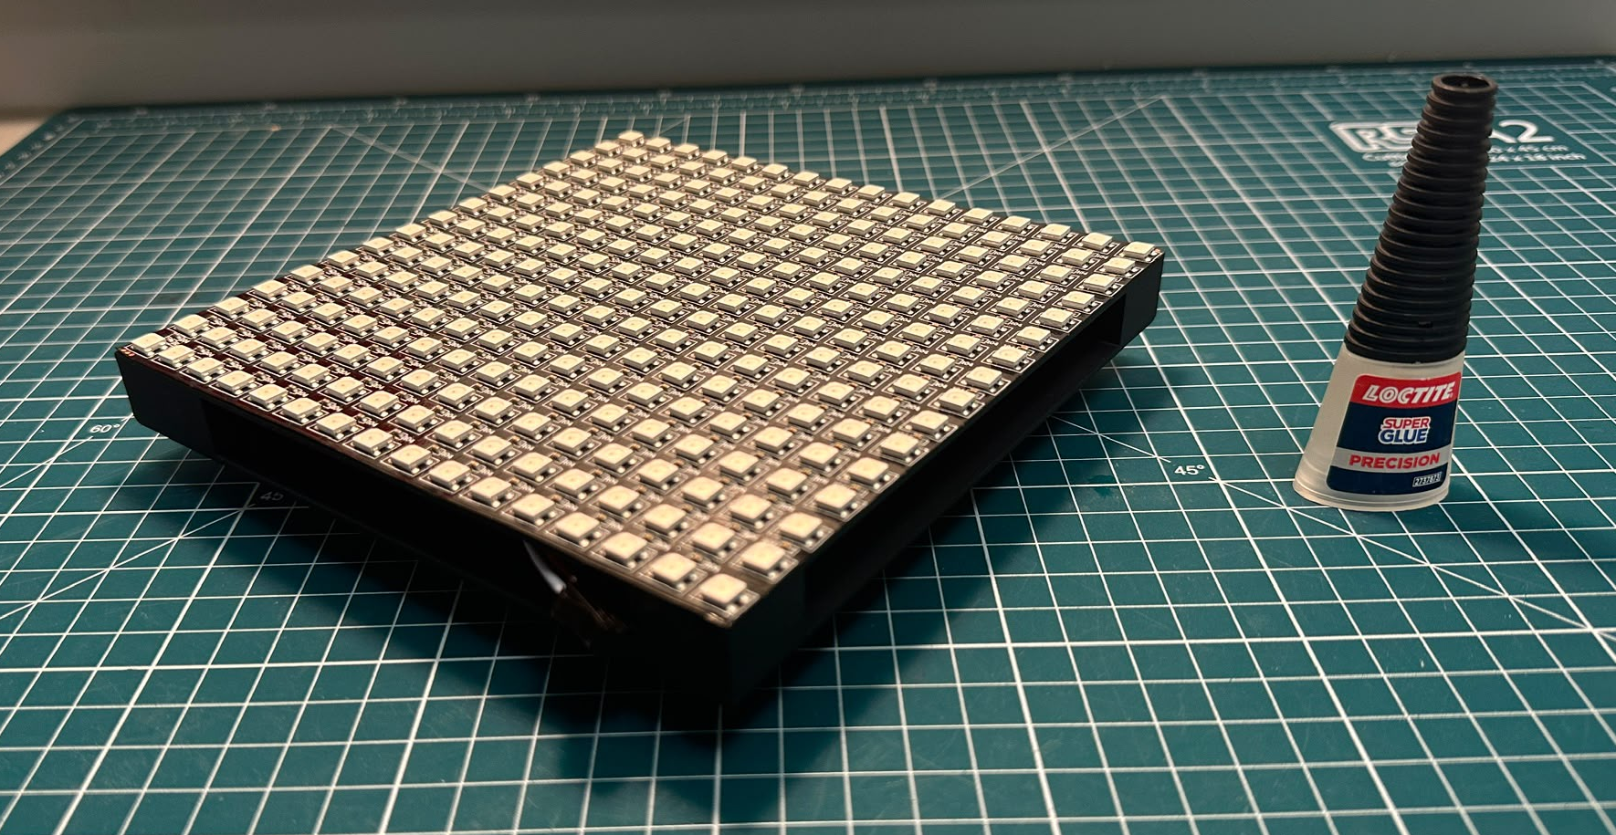
Step 1
What you will need:
LED box holder
LED array
Super-glue
TODO:
Thread LED wires through the square holes in the 3D printed box. Position the LED array to the edges of the box and superglue along the edges and the middle to ensure good contact.
Place upside-down on a flat surface and leave to dry.

Slide 6
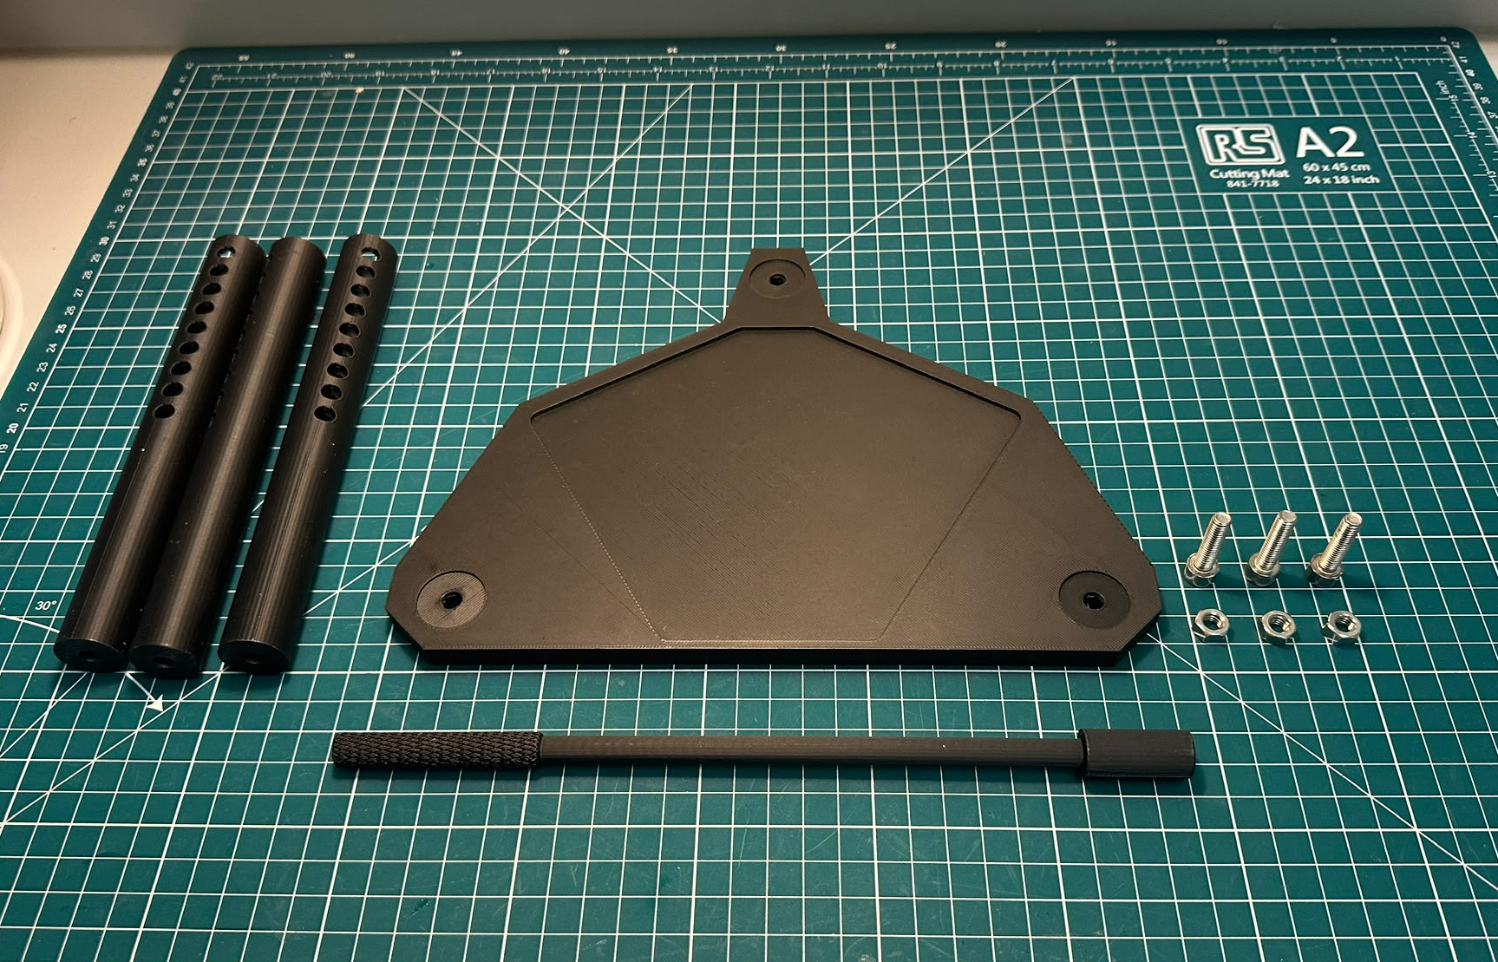
Step 2(a)
What you will need:
External posts
Microscope base plate
Hex nut tool
M6x25 mm bolts (x3)
M6 nuts (x3)

Slide 7
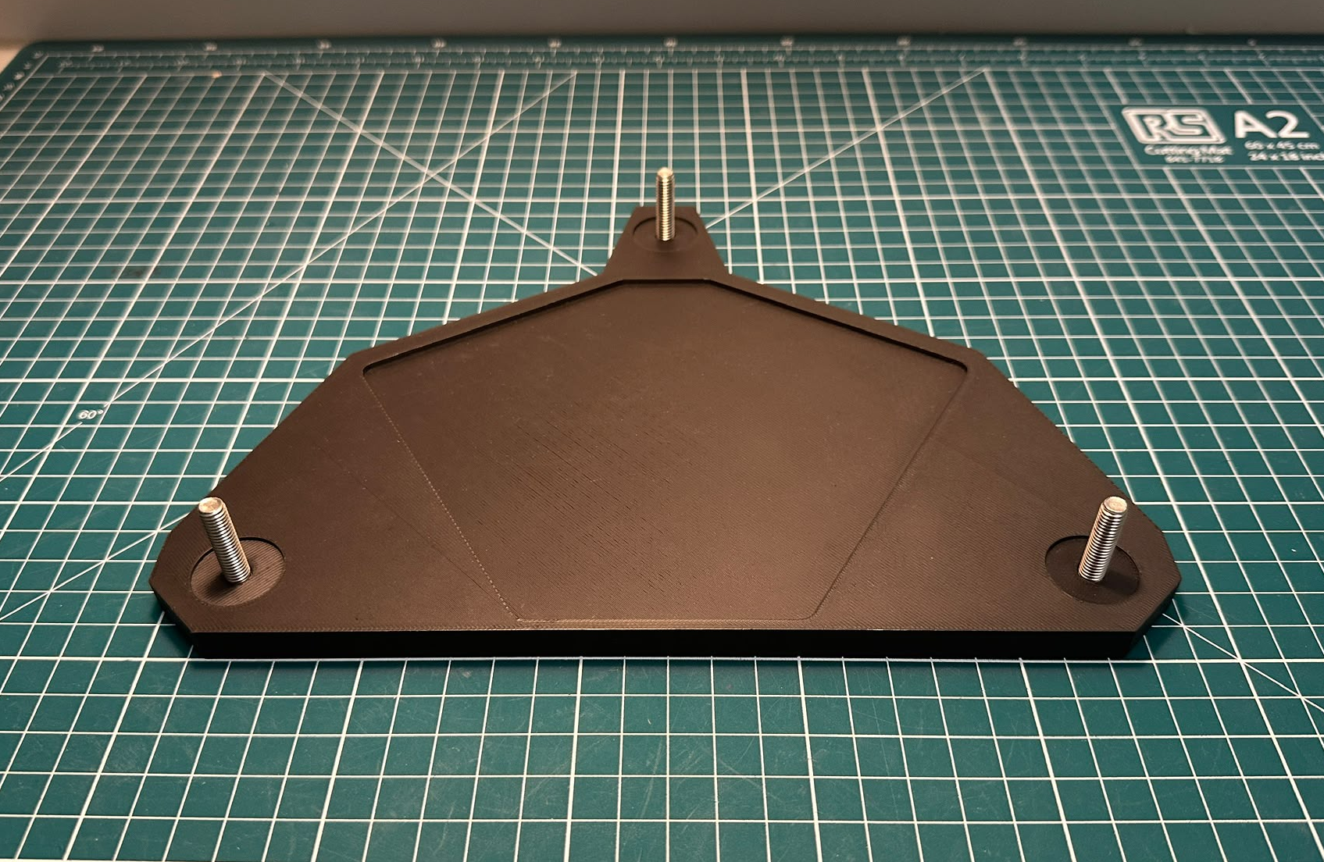
Step 2(b)
TODO:
Place the 3 M6x25 mm bolts through the bottom of the microscope base plate.

Slide 8
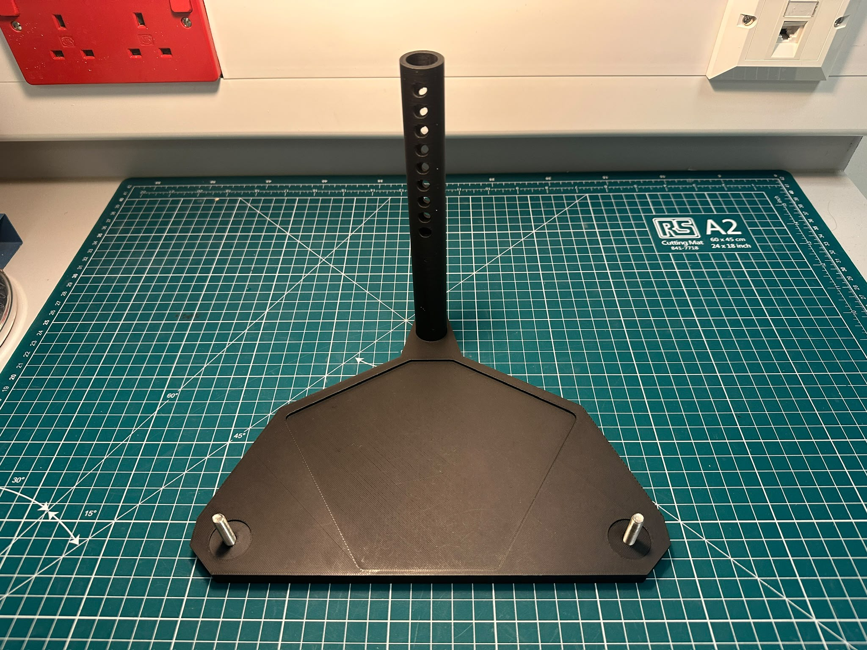
Step 2(c)
TODO:
Next, place one of the external posts onto a bolt.

Slide 9
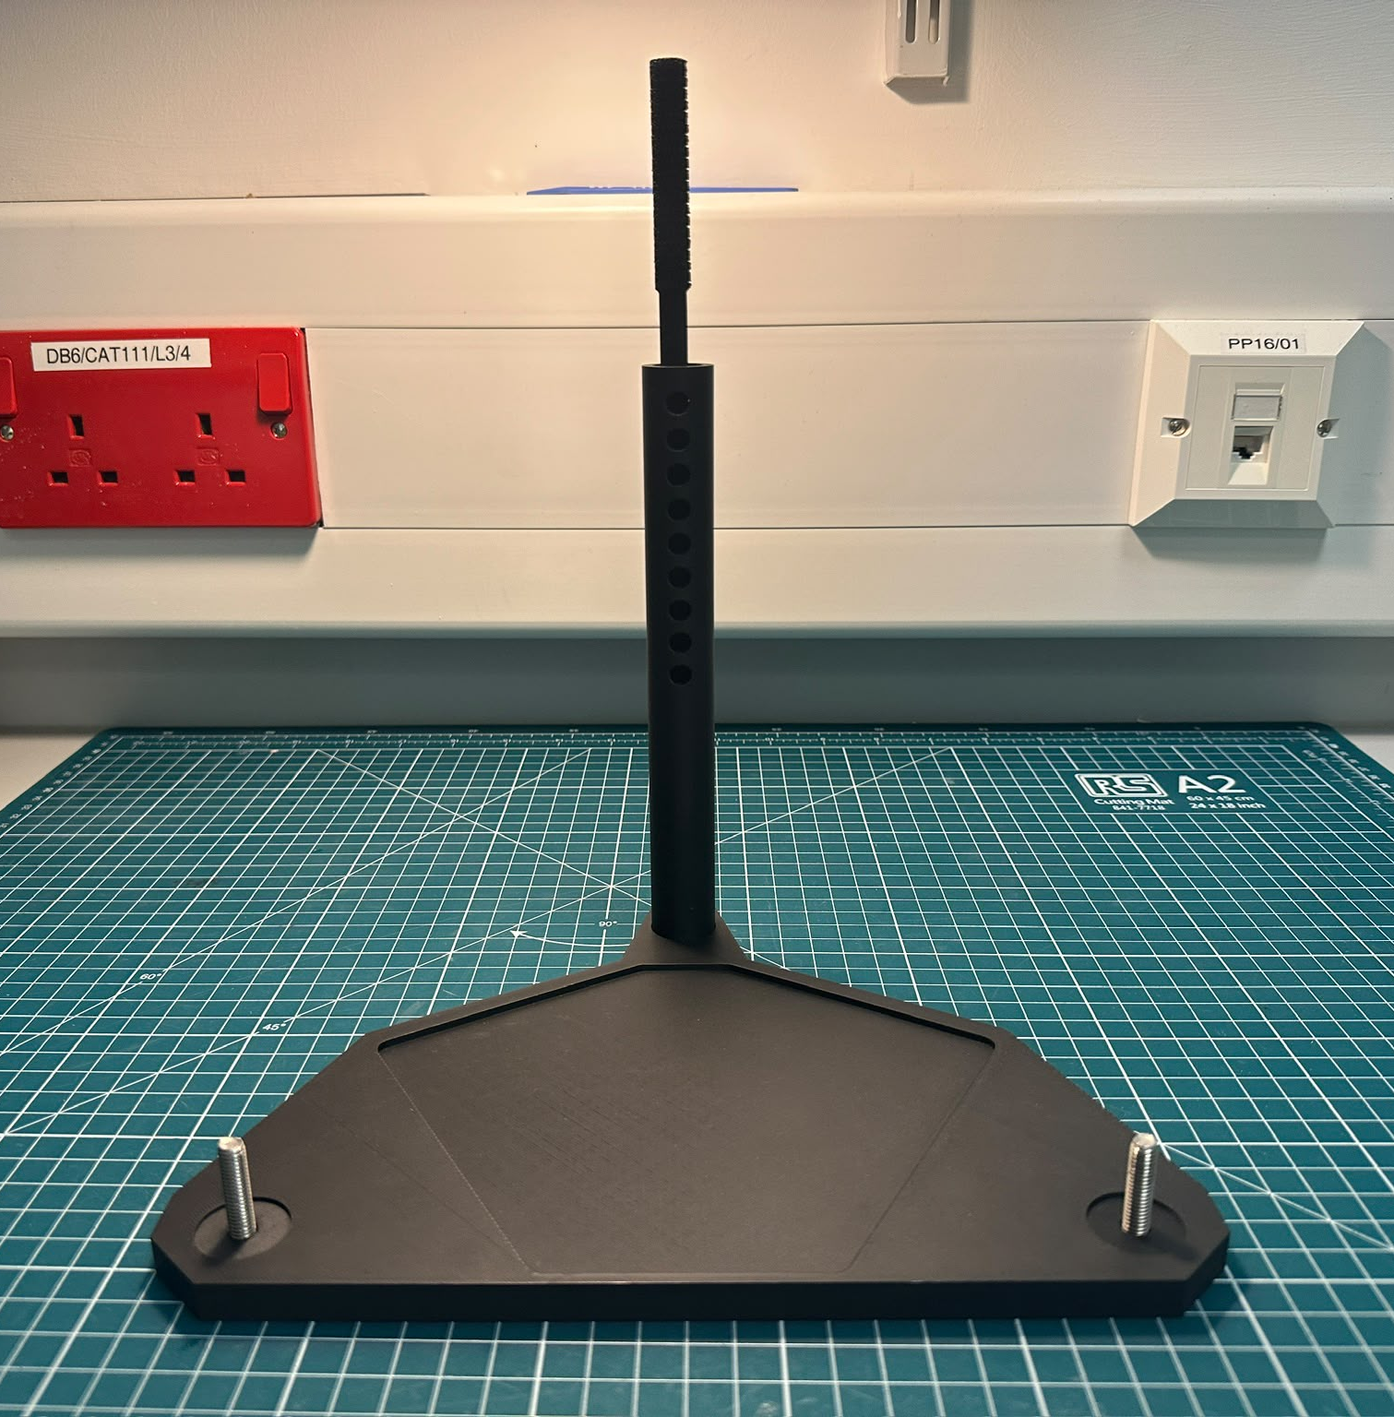
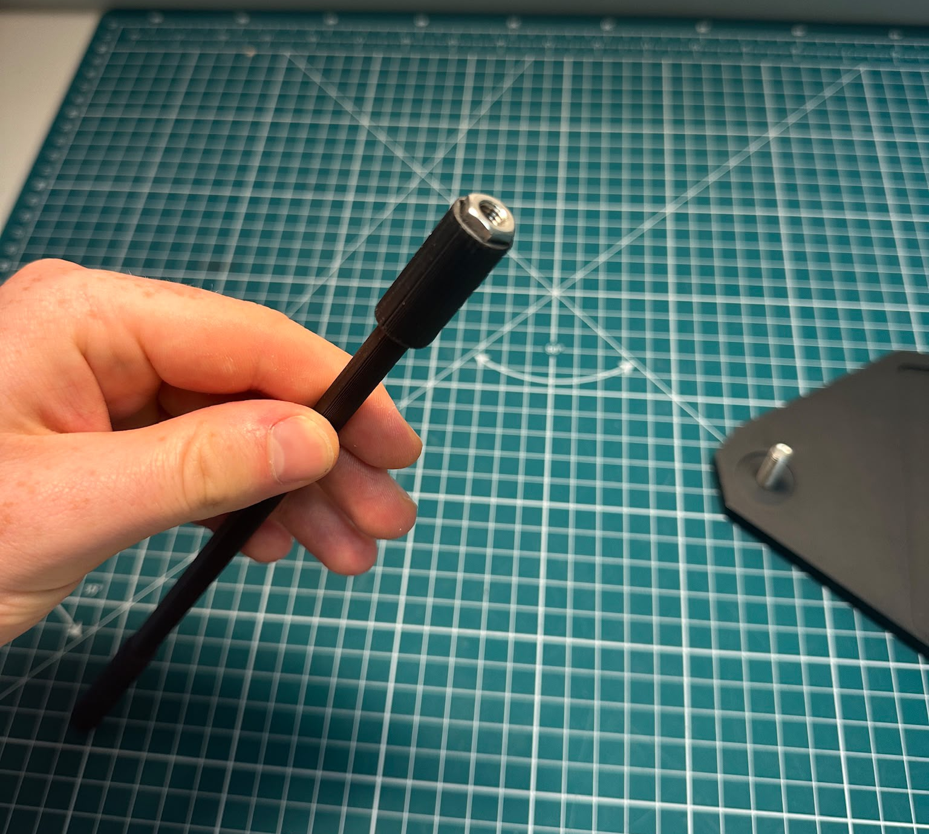
Step 2(d)
TODO:
Using the hex nut tool, carefully screw an M6 nut onto the bolt to attach the external post
Tip:
Place nut and hex tool into external post to ensure good contact before placing the post onto the bolt and threading.

Slide 10
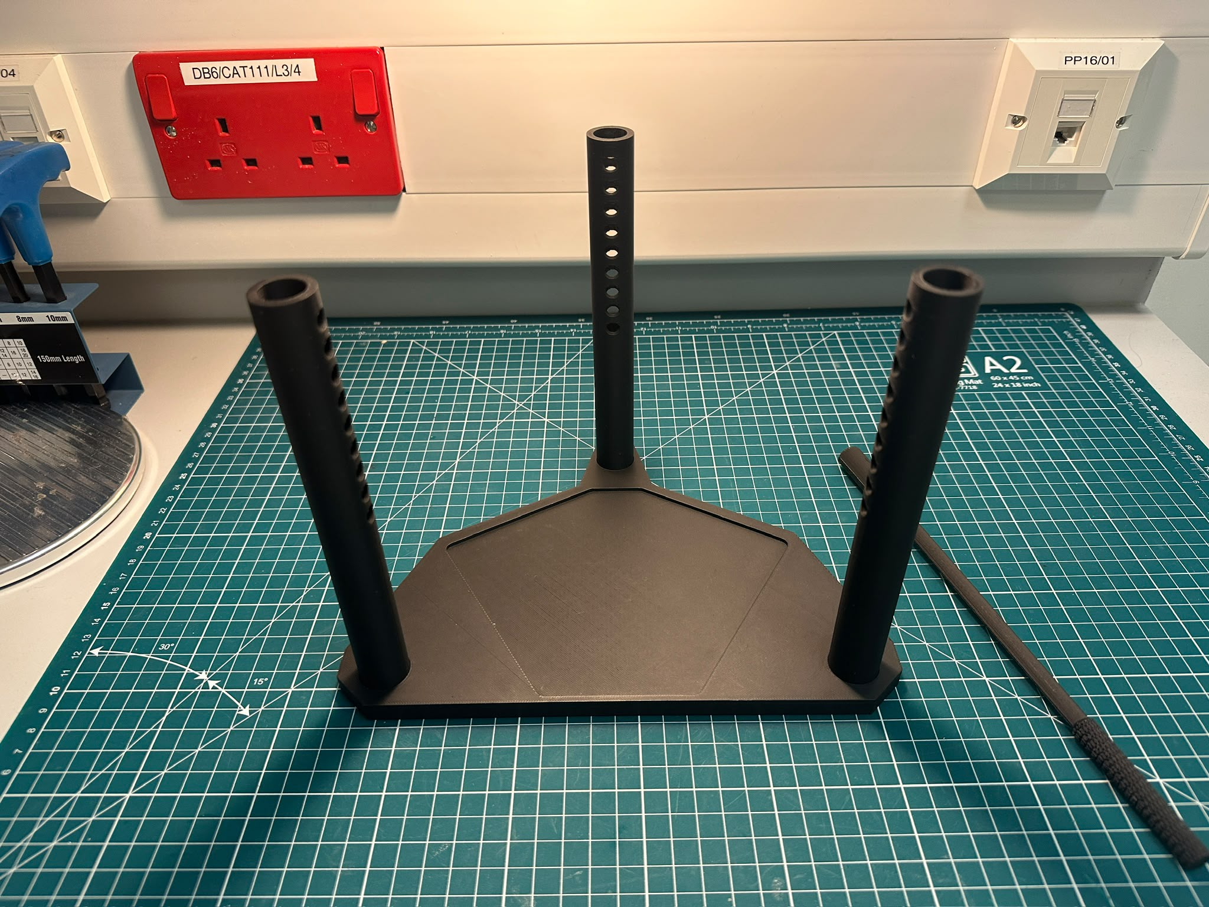
Step 2(e)
TODO:
Repeat Step 2 (c) and (d) for the remaining two external posts.
Each post can be twisted into positions (shown on the image) and retightened if required.

Slide 11
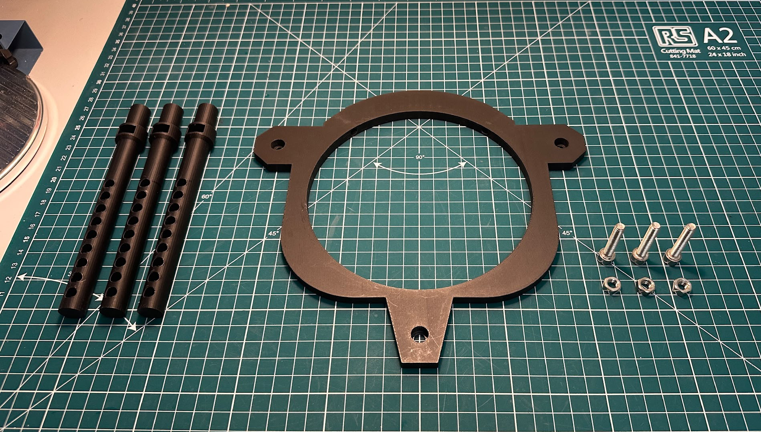
Step 3(a)
What you will need:
Internal posts
LED canopy
M6x30 mm bolts (x3)
M6 nuts (x3)
Tools:
5 mm hex key M6 tool
2.5 mm hex key M3 tool

Slide 12
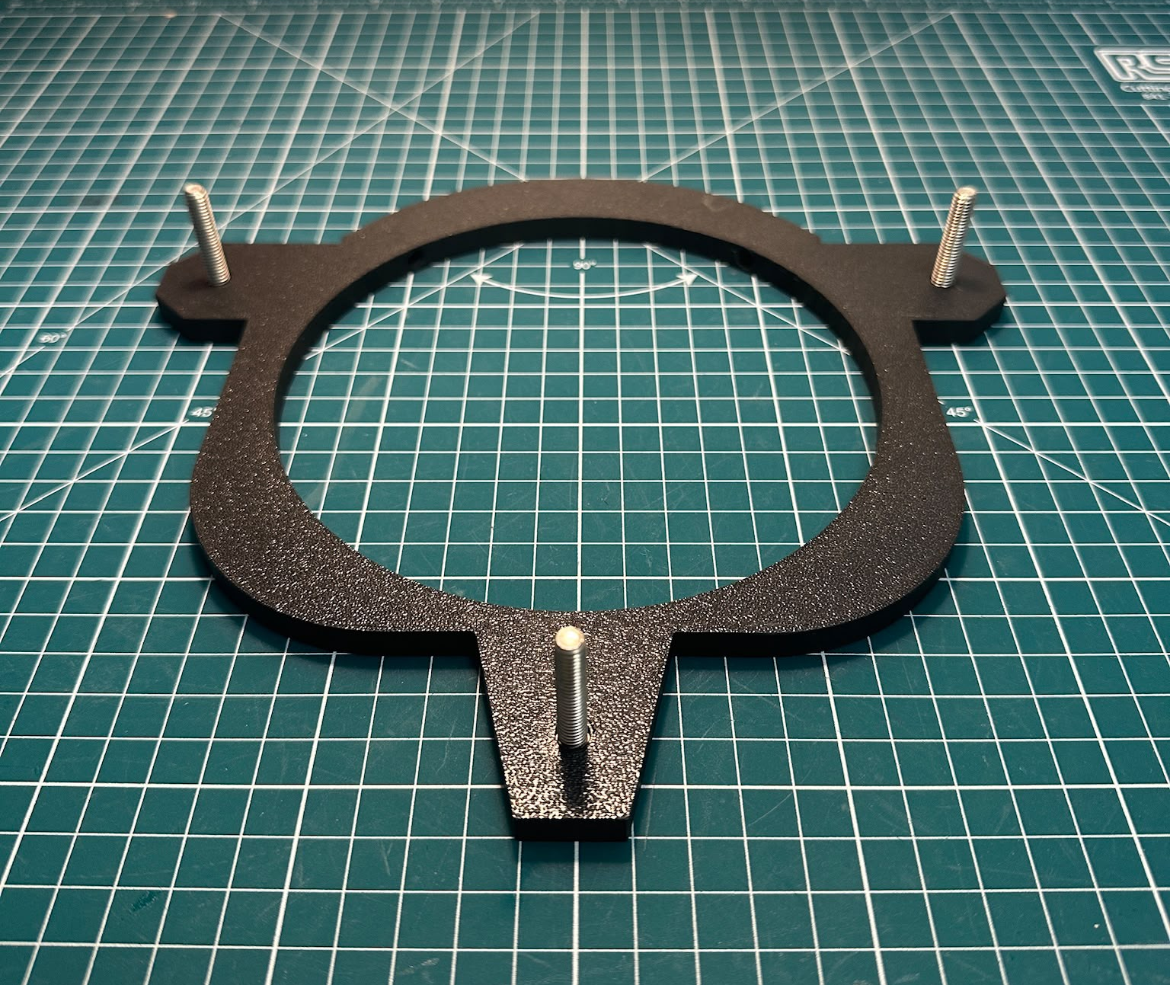
Step 3(b)
TODO:
Place the 3 M6x30 mm bolts through the top of the LED canopy, so that the top of each bolt is flush to the surface.

Slide 13
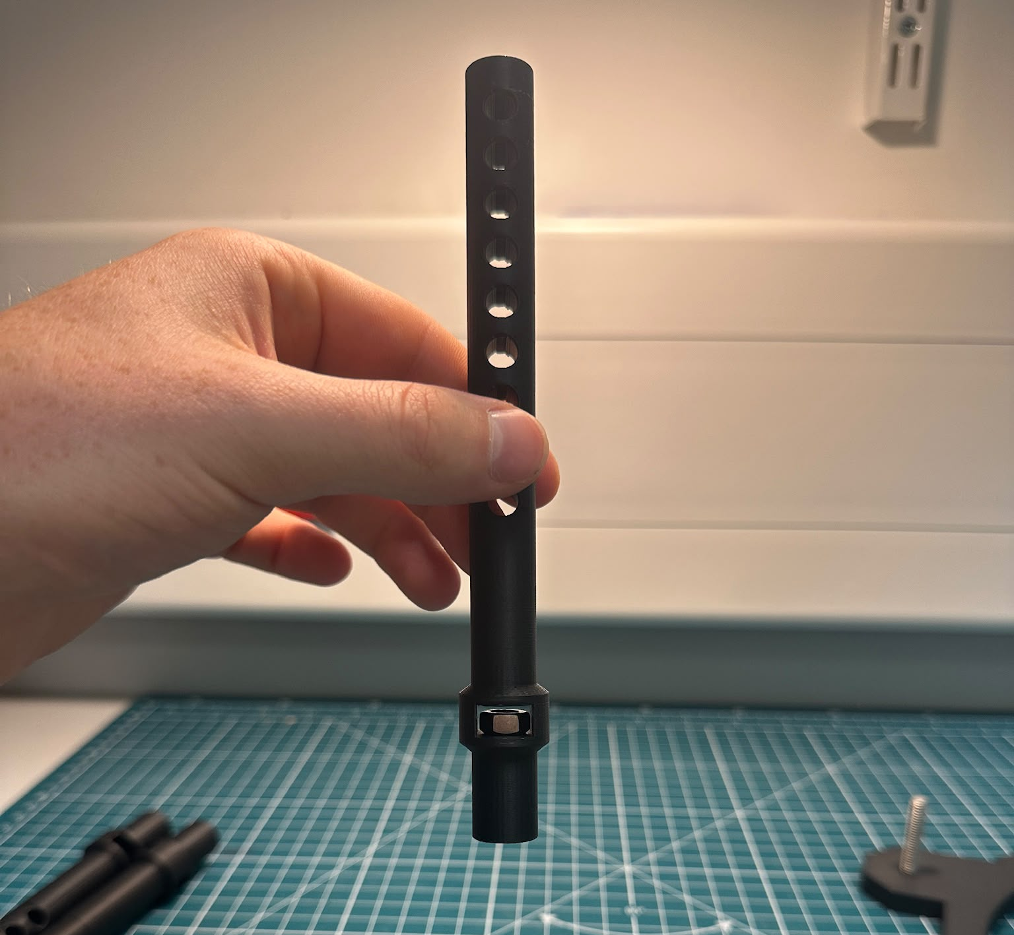
Step 3(c)
TODO:
Next, carefully place an M6 nut into the slot of the Internal posts

Slide 14
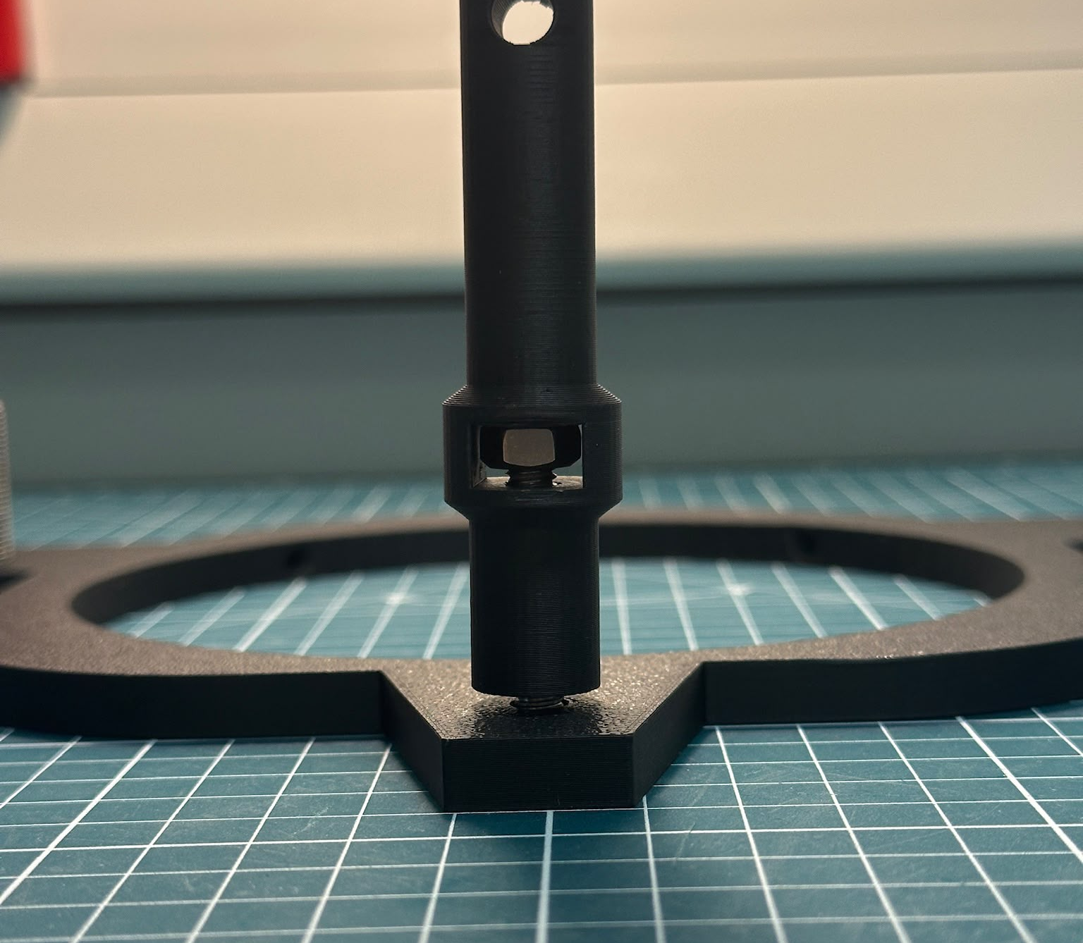
Step 3(d)
TODO:
Afterwards, connect one the internal post to one of the bolts attached to the LED canopy.

Slide 15
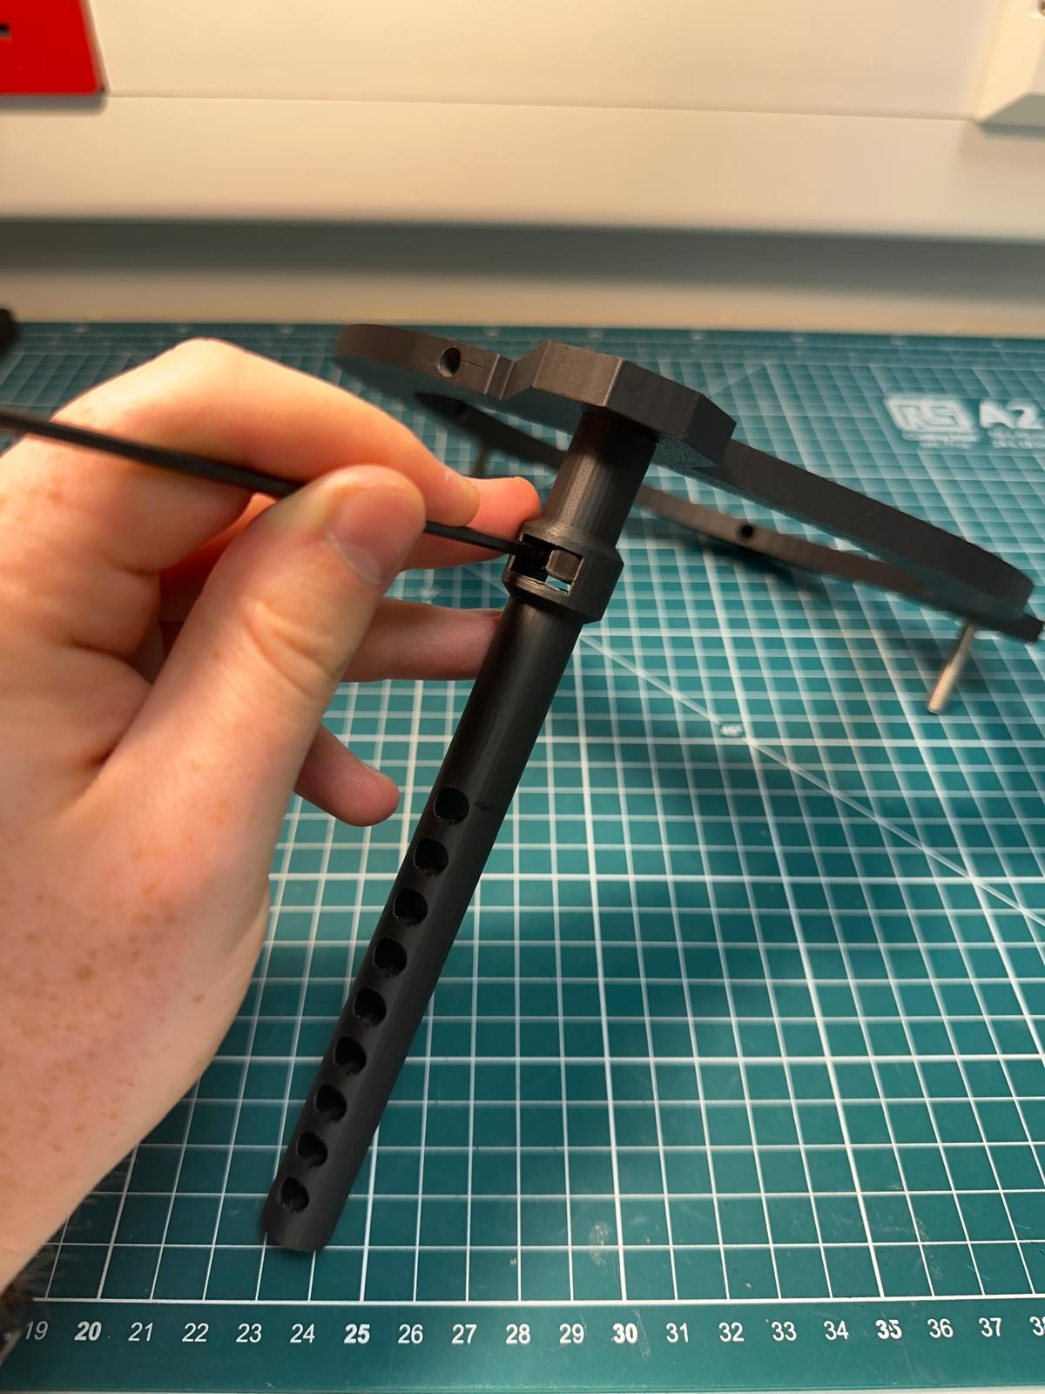
Step 3(e)
TODO (Tricky):
A 2.5 mm hex key M3 tool (or similar) can be used to wedge the M6 nut in place.

Slide 16
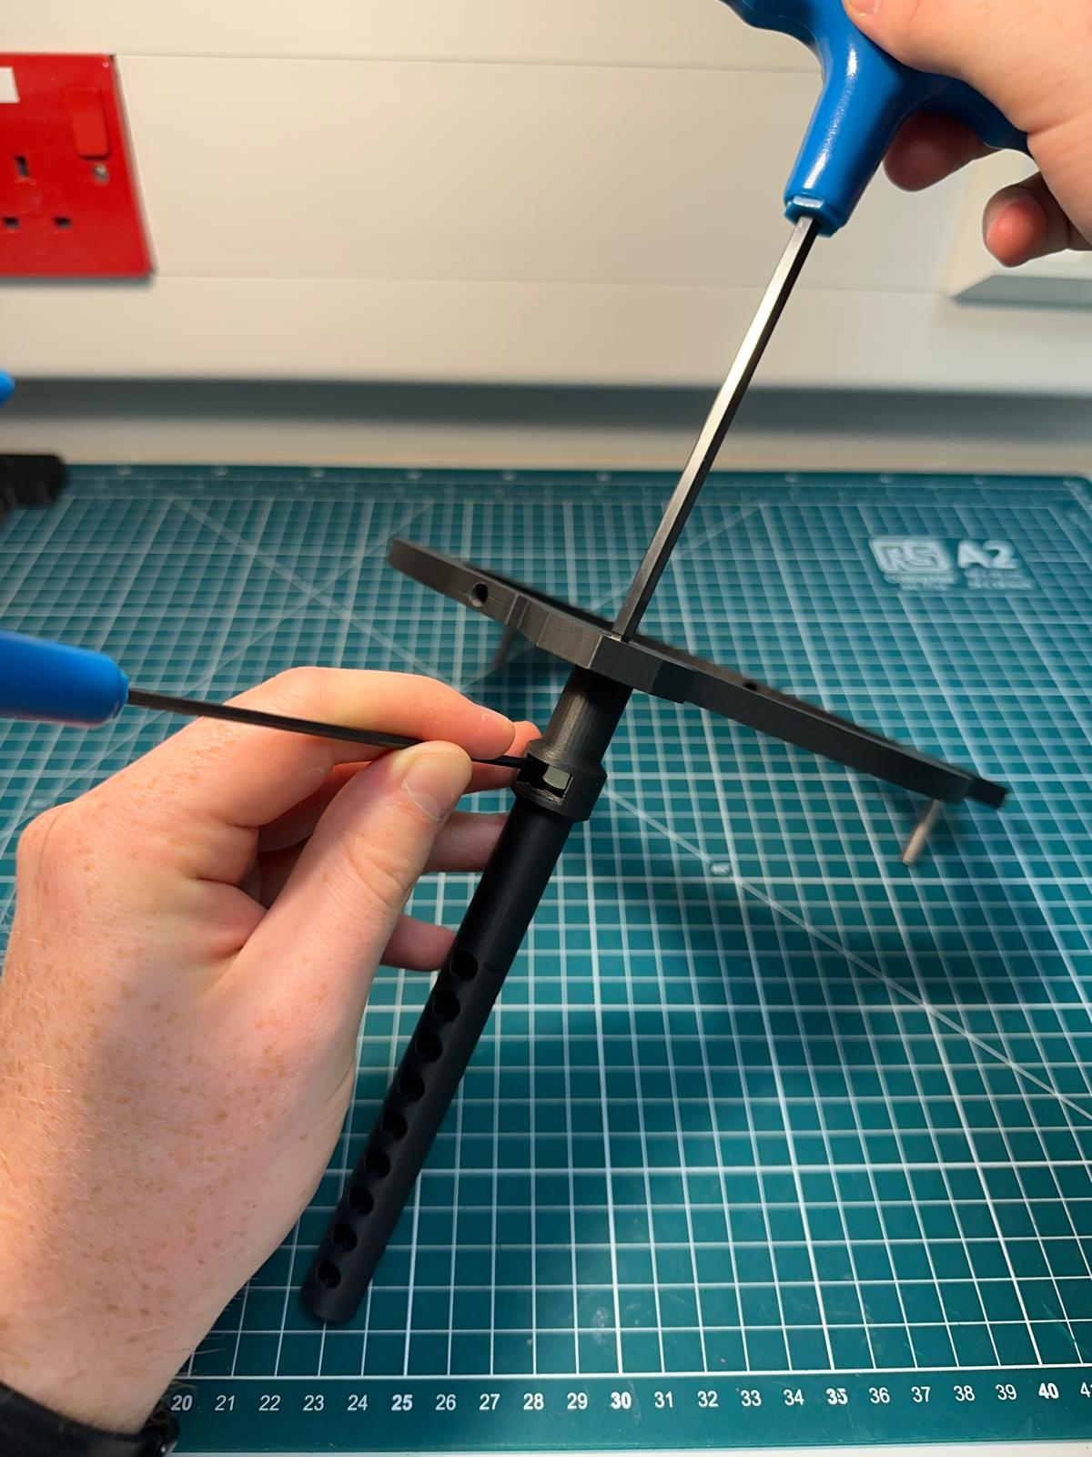
Step 3(f)
TODO (Tricky):
Once the M6 nut is securely wedged, a 5 mm hex key M6 tool can be used to tighten the M6 bolt.
Tip:
Use both hands to secure the nut and tighten the bolt simultaneously, you can also grip onto the post.

Slide 17
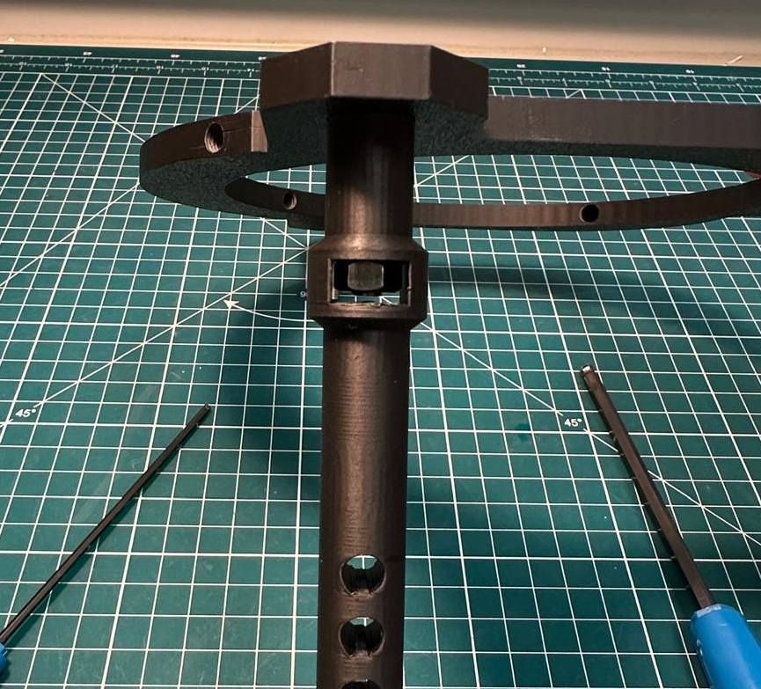
Step 3(g)
TODO:
Once tightened, visually inspect the assembly. The post should look like this.

Slide 18
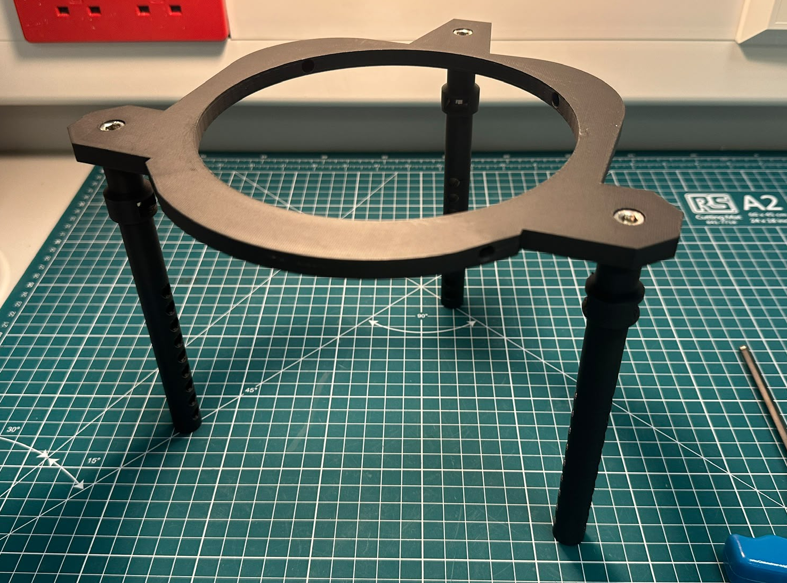
Step 3(h)
TODO:
Repeat Step 3 (c-g) for the remaining two internal posts.

Slide 19
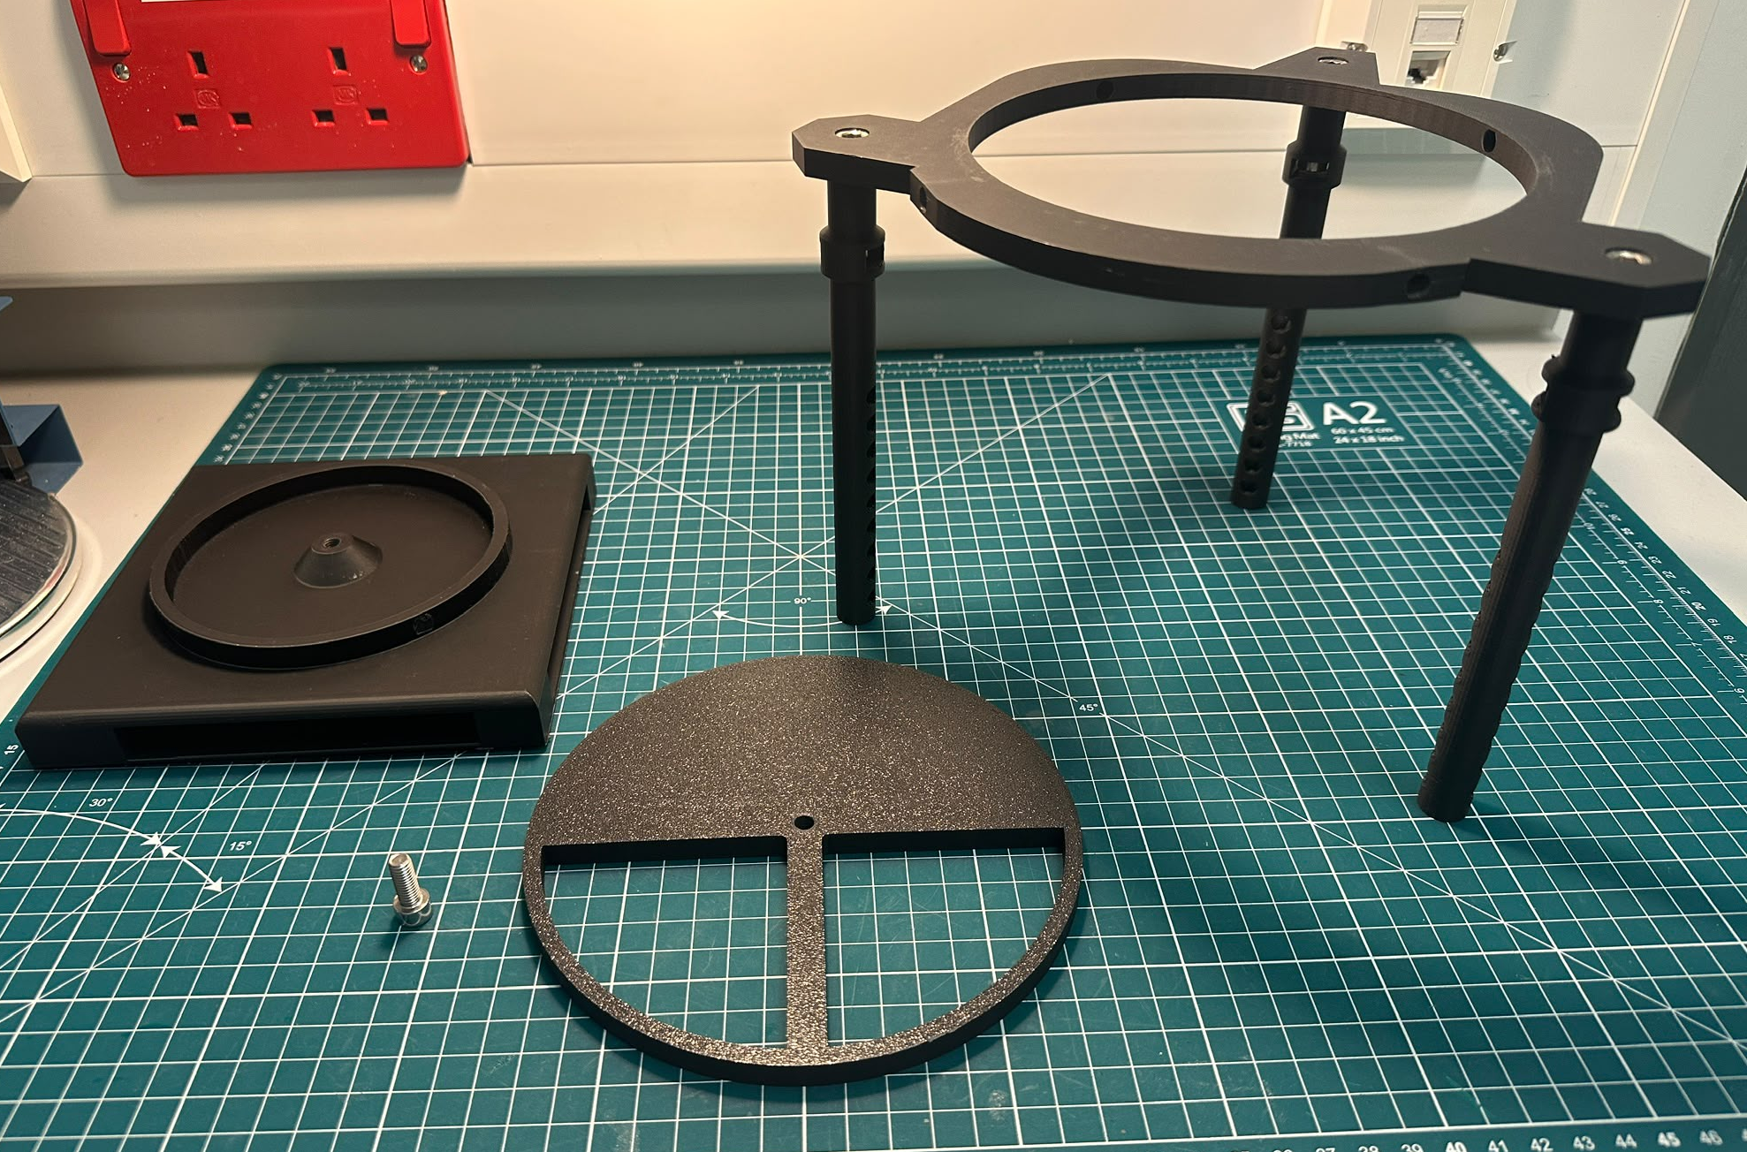
Step 4(a)
What you will need:
LED box holder with LED array attached
LED box hat
Assembly of LED canopy to internal posts
M6x16 mm bolt (x1)

Slide 20
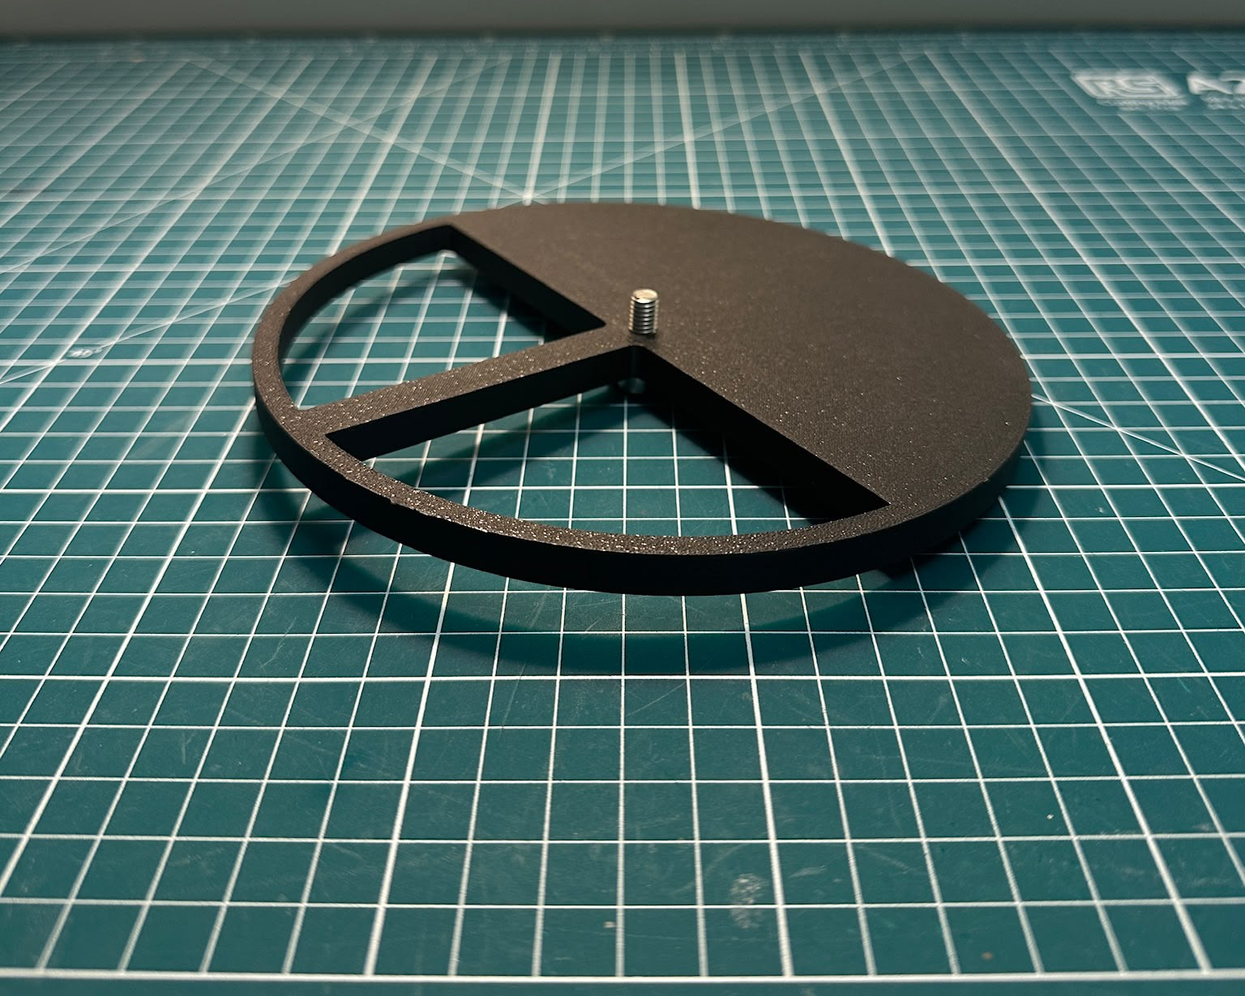
Step 4(b)
TODO:
Screw the M6x16 mm bolt into the LED box hat

Slide 21
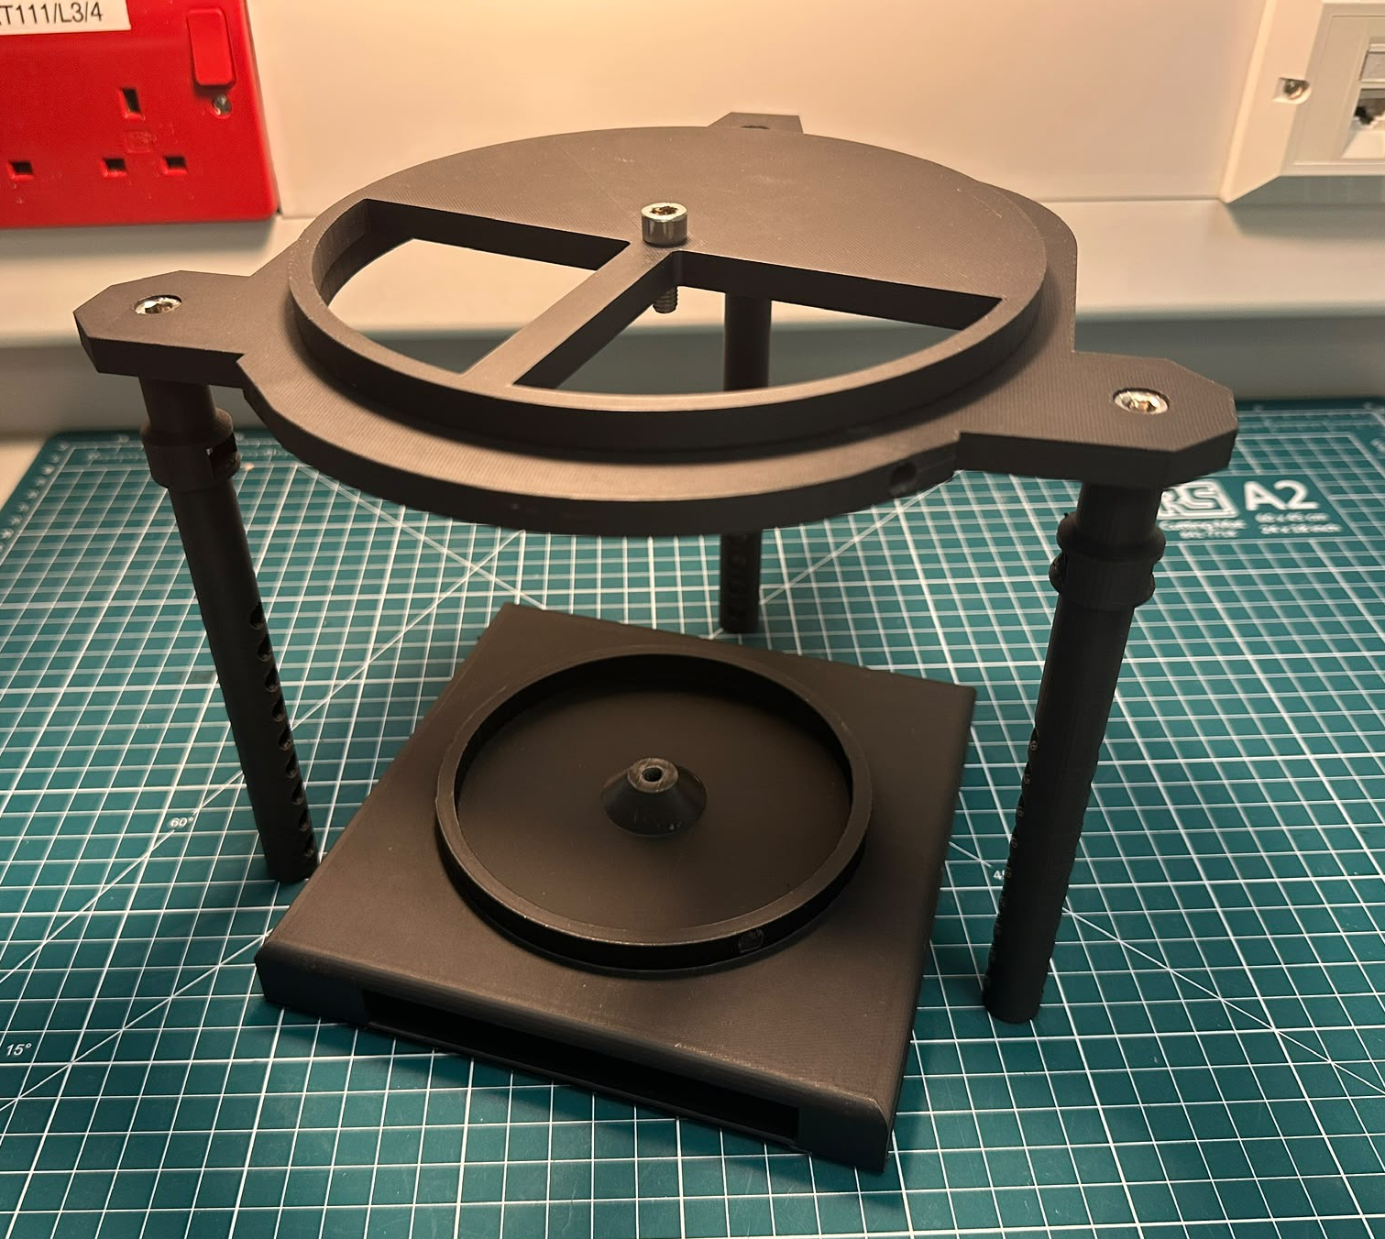
Step 4(c)
TODO:
Position the components into the following layout.

Slide 22
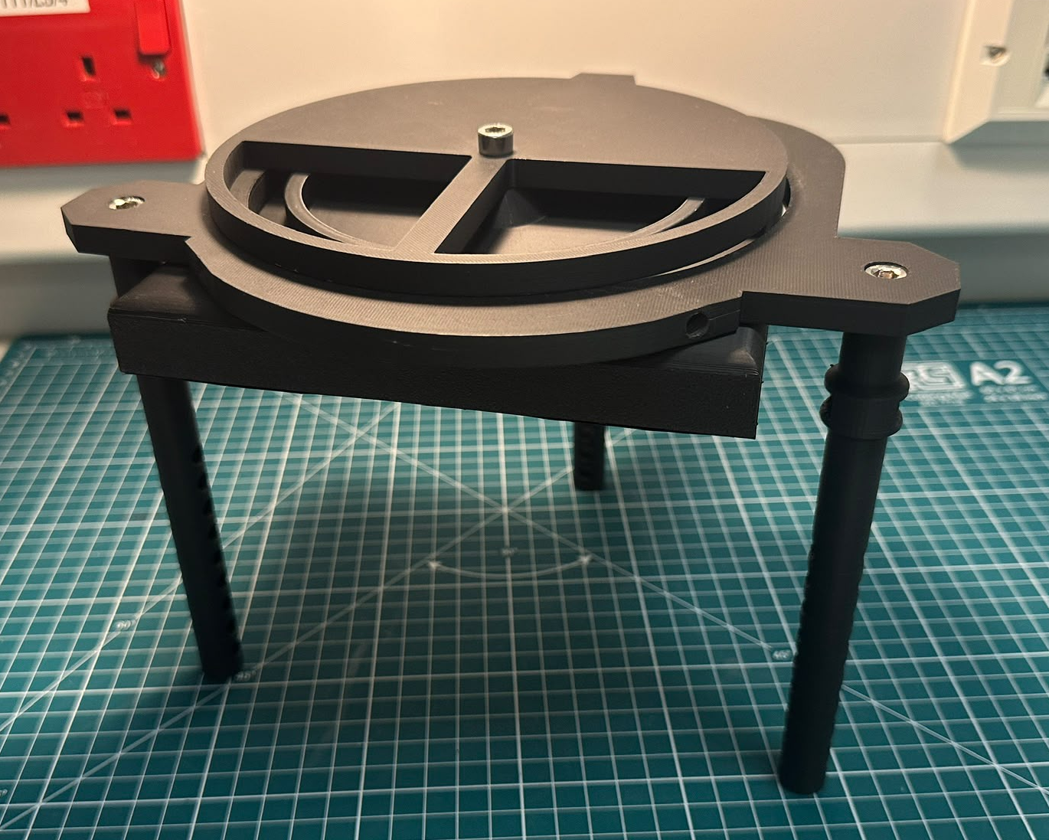
Step 4(d)
TODO:
Lift the LED box holder up and twist the LED box hat on top until tightly secured.

Slide 23
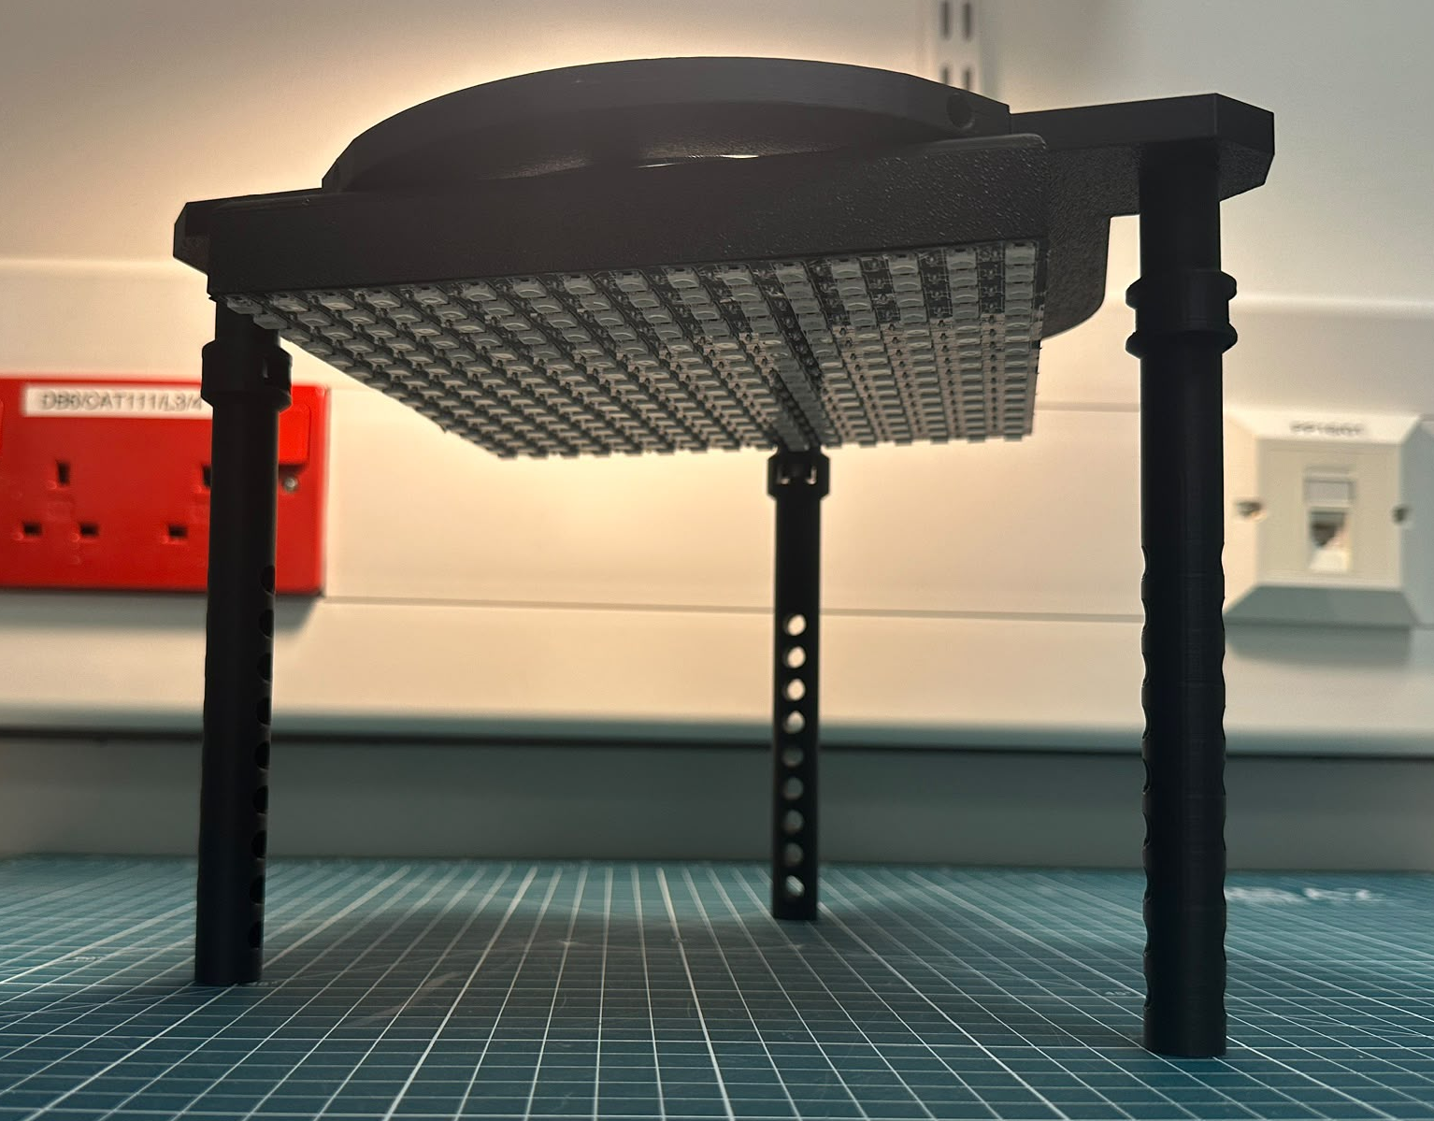
Step 4(e)
TODO:
The LED array should now be secured in the Z-axis on the canopy and translatable in X and Y axes.

Slide 24
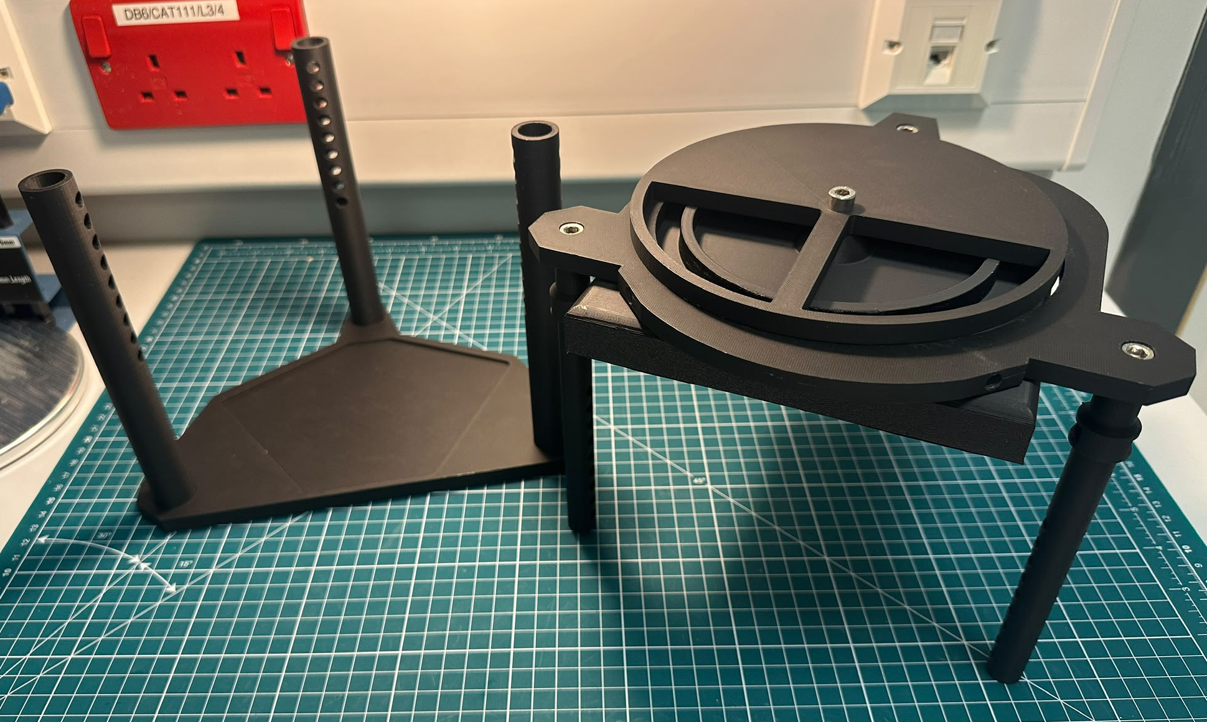
Step 5(a)
What you will need:
Microscope base plate and external posts assembly
Illuminator canopy and internal posts assembly

Slide 25
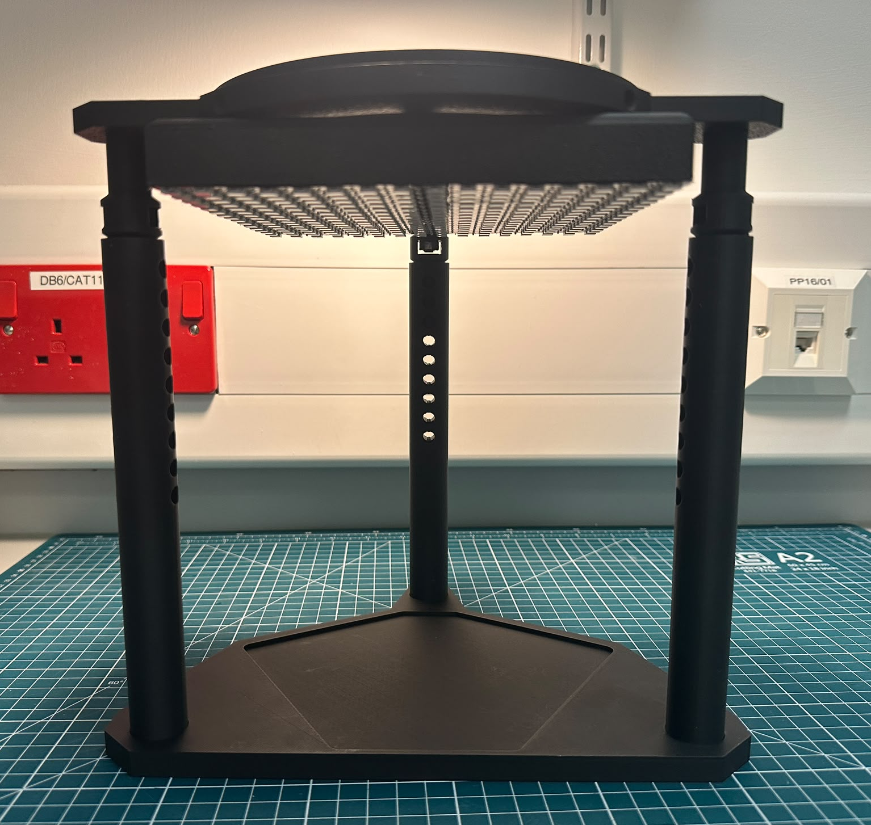
Step 5(b)
TODO:
Insert the internal posts into the external posts.

Slide 26
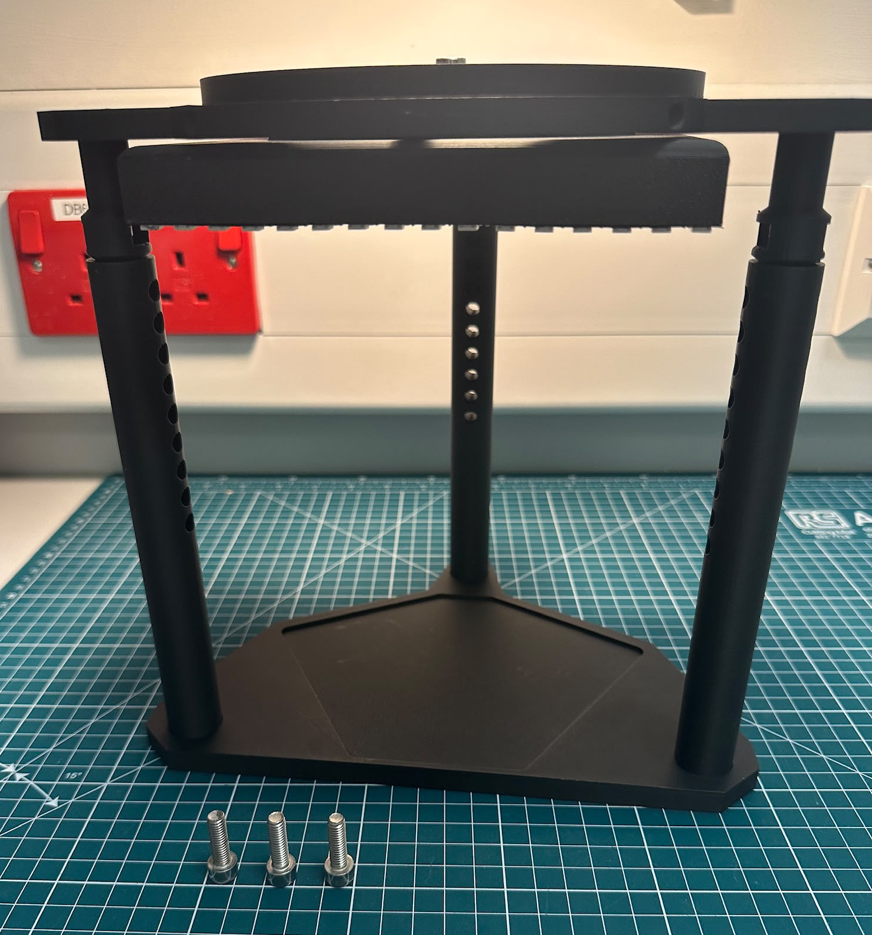
Step 6(a)
What you will need:
Full illuminator assembly
M6x20 mm bolts (x3)

Slide 27
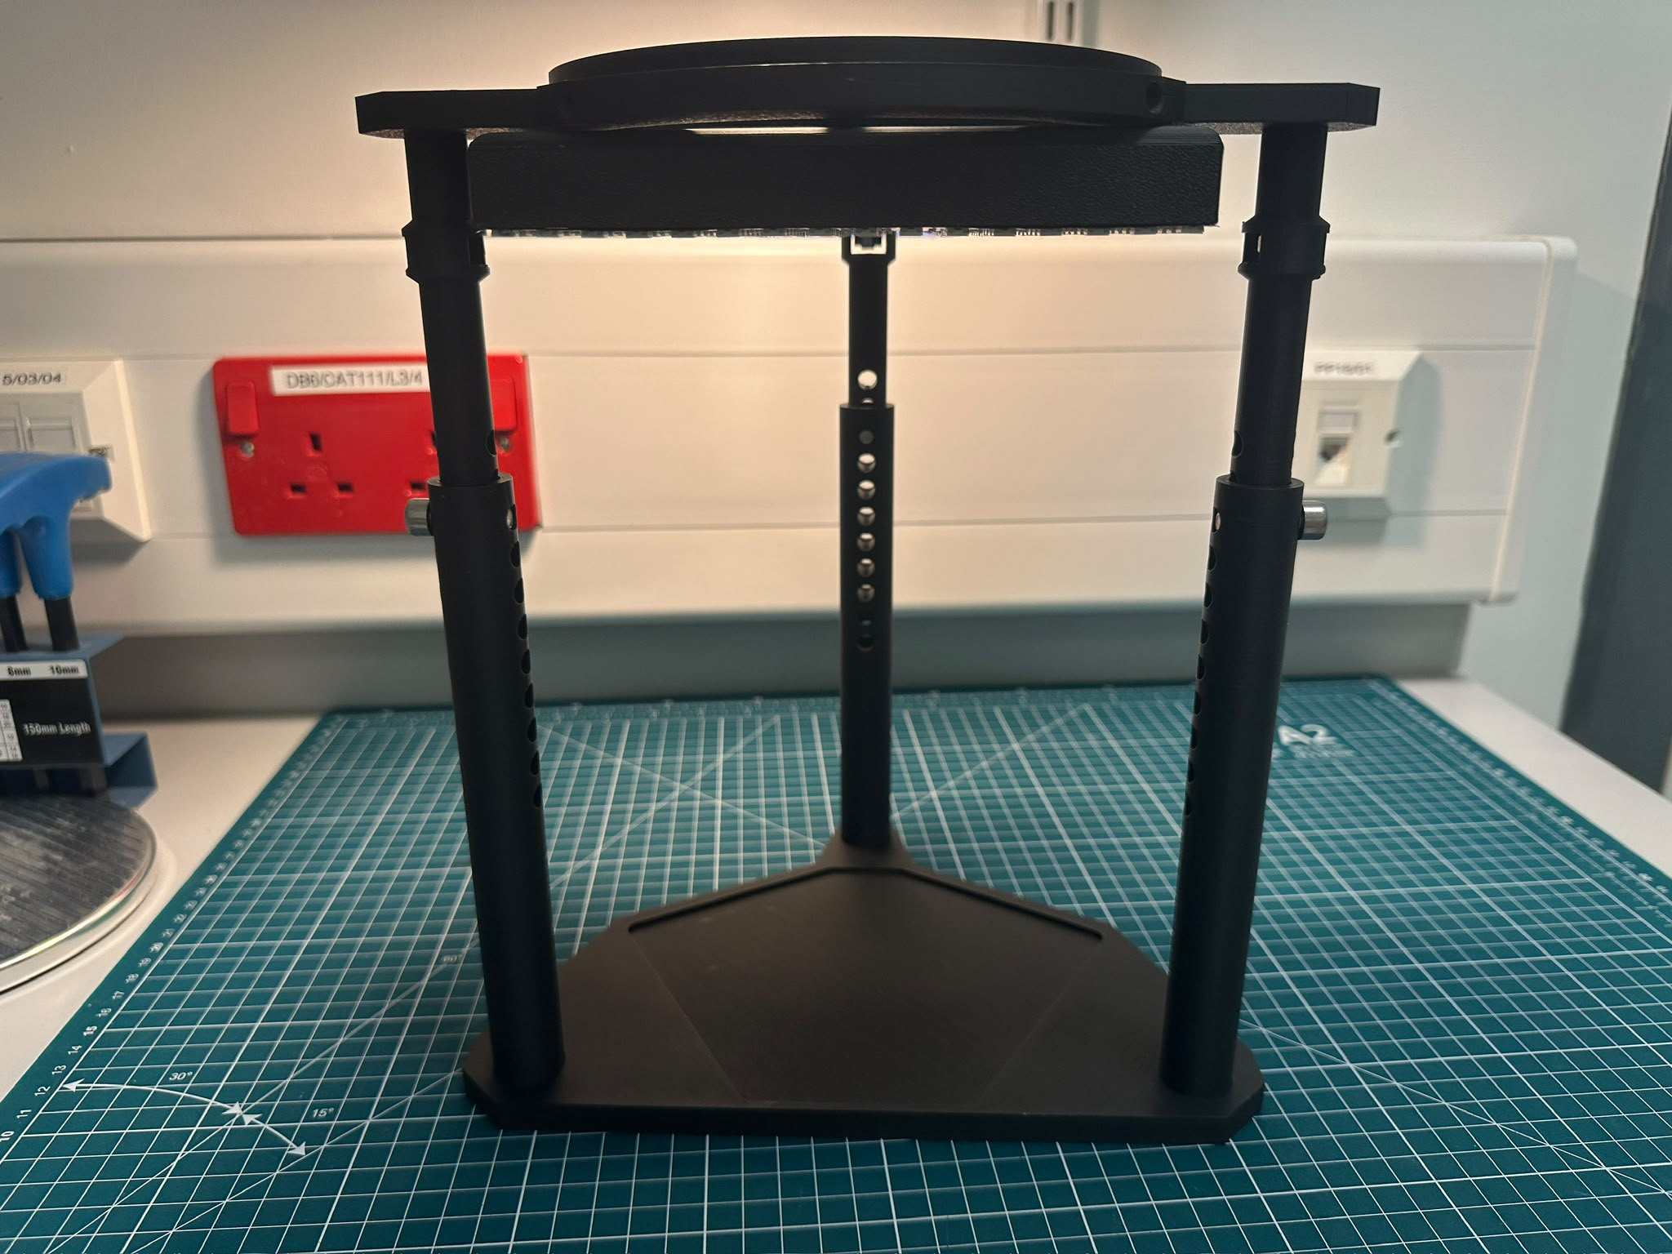
Step 6(b)
TODO:
Insert the M6x20 mm bolts through the posts for a fixed LED height.
Note:
The height can be further adjusted once the microscope is attached and is measured from the LED array to the sample plane.

Slide 28
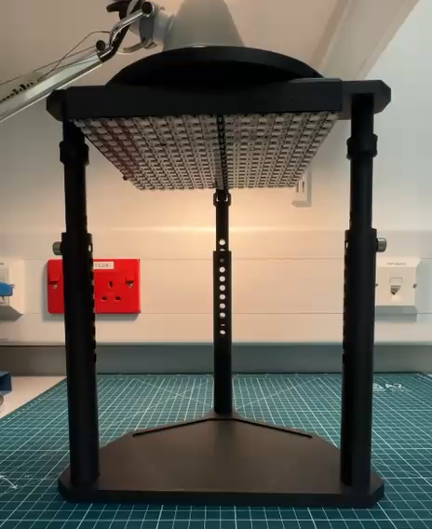
Finishing Video
TODO:
You should now be able to translate the LED array as seen in this demo video.

